Slide 1

Diodes and Rectifiers
Unit 18 Semiconductors
Unit 19 Diode Applications
Unit 20 Special Purpose Diodes

Slide 2

2018/19 S1
Modified Examination Questions

Slide 3

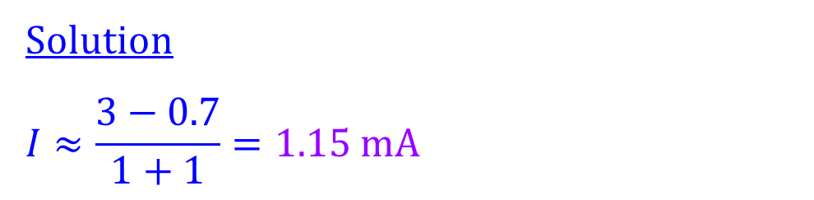
18/19 S1 A6 (modified)
Explanation
Calculate the forward current of the silicon diode.
1 kΩ
Solution
$$I≈\frac{3−0.7}{1+1}=1.15 mA$$
I
3 V
1 kΩ
1 of 1

Slide 4
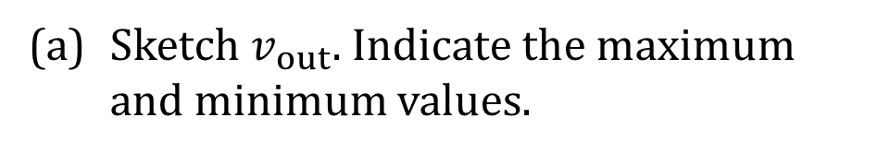
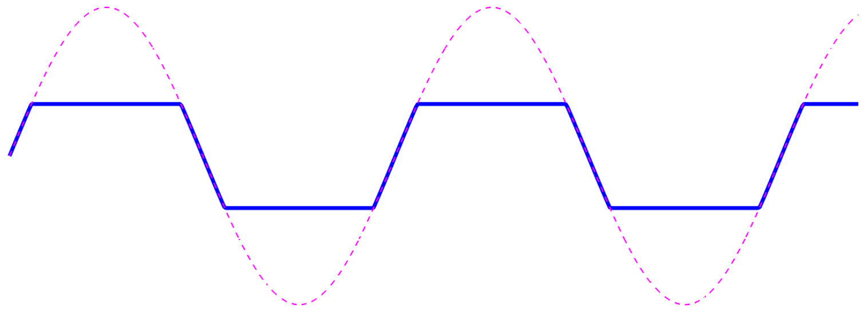

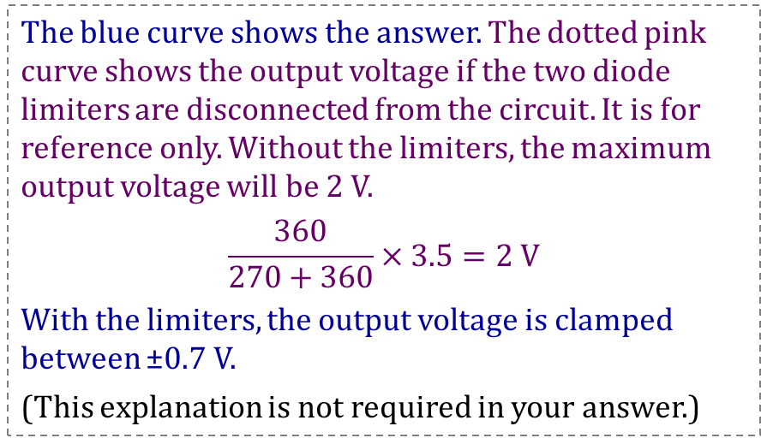




18/19 S1 B2 (modified)
Explanation
$$I_{in}$$
270 Ω
$$I_{out}$$
Silicon diodes are used in the circuit.
$v_{in}$
(a) Sketch $v_{out}$. Indicate the maximum and minimum values.
+
+
3.5 V
0 V
360 Ω
$$v_{out}$$
t
Solution
The diode limiters clip the output voltage between ±0.7 V.
−3.5 V
−
−
The blue curve shows the answer. The dotted pink curve shows the output voltage if the two diode limiters are disconnected from the circuit. It is for reference only. Without the limiters, the maximum output voltage will be 2 V.
$$\frac{360}{270+360}×3.5=2 V$$
With the limiters, the output voltage is clamped between ±0.7 V.
(This explanation is not required in your answer.)
volt
2
$$v_{out}(t)$$
0.7
0
−0.7
t
−2
The pink dotted curve is not required in your answer. It is just for reference.
1 of 2

Slide 5
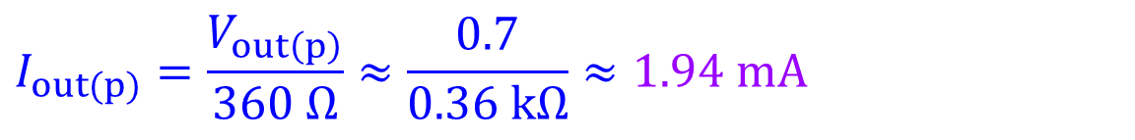
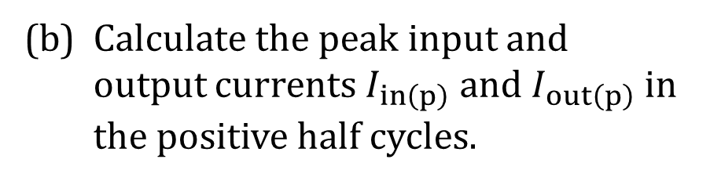
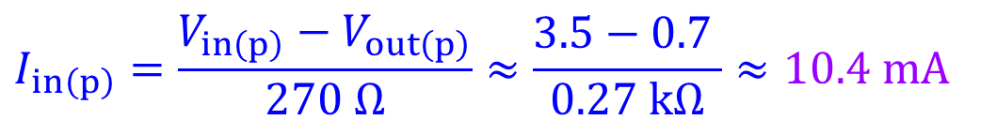
18/19 S1 B2 (modified)
$$I_{in}$$
270 Ω
$$I_{out}$$
(b) Calculate the peak input and output currents $I_{in\left(p\right)}$ and $I_{out\left(p\right)}$ in the positive half cycles.
$v_{in}$
3.5 V
+
+
0 V
360 Ω
$$v_{out}$$
t
−3.5 V
−
−
Solution
$$I_{in\left(p\right)}=\frac{V_{in\left(p\right)}−V_{out\left(p\right)}}{270 Ω}≈\frac{3.5−0.7 }{0.27 kΩ}≈10.4 mA$$
$$I_{out(p)}=\frac{V_{out\left(p\right)}}{360 Ω}≈\frac{0.7}{0.36 kΩ}≈1.94 mA$$
2 of 2

Slide 6
2017/18 S2
Modified Examination Questions

Slide 7
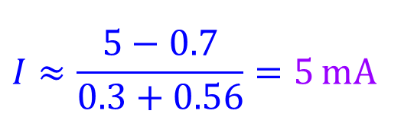
17/18 S2 A6 (modified)
Explanation
Silicon diodes are used in the circuit. Calculate current I.
Solution
The diode connected in parallel with the 300 Ω resistor is reverse biased, and no current flows through this diode. But the diode connected in series with the 560 Ω is forward biased.
300 Ω
I
5 V
560 Ω
$$I≈\frac{5−0.7}{0.3+0.56}=5 mA$$
1 of 1

Slide 8
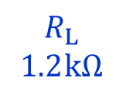
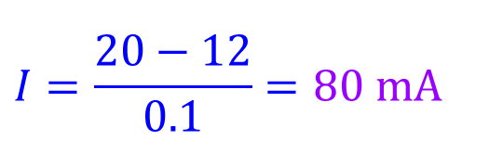


17/18 S2 A9 (modified)
Explanation
100 Ω
I
The Zener regulator circuit operates at a Zener voltage of 12 V. Calculate current I.
$$I_{Z}$$
$$I_{L}$$
$$R_{L}$$ 1.2 kΩ
20 V
Solution
$$I=\frac{20−12}{0.1}=80 mA$$
1 of 1

Slide 9
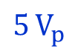
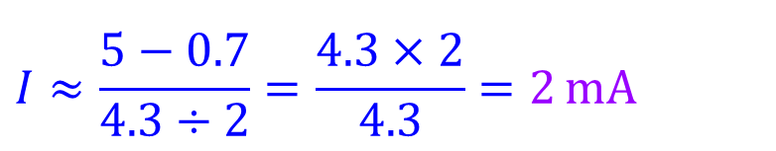
17/18 S2 A10 (modified)
Explanation
I
Calculate the peak forward current I of the silicon diode.
+
Solution
$5 V_{p}$
4.3 kΩ
4.3 kΩ
$$I≈\frac{5−0.7}{4.3÷2}=\frac{4.3×2}{4.3}=2 mA$$
−
1 of 1

Slide 10
17/18 S2 B2 (modified)
Explanation
(a) The output of a dc power supply after rectification and filtering is a DC voltage with a small ripple riding on it. Name a device that can further improve the output to an almost perfect DC voltage.
Solution
Voltage regulator.
1 of 5

Slide 11
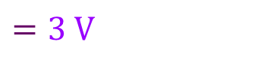
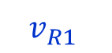
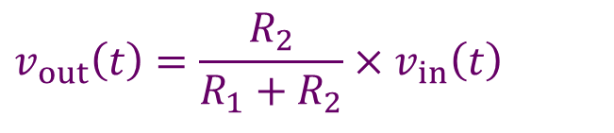
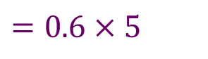
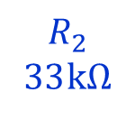
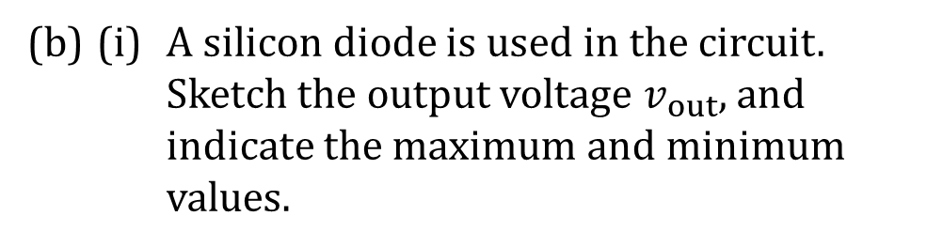

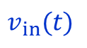
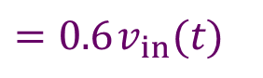

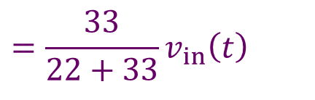
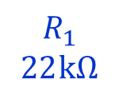
17/18 S2 B2 (modified)
$$v_{R1}$$
(b) (i) A silicon diode is used in the circuit. Sketch the output voltage $v_{out}$, and indicate the maximum and minimum values.
+
−
$v_{in}(t)$
+
$$R_{1}$$
22 kΩ
+
5 V
$$R_{2}$$
33 kΩ
0 V
$$v_{out}$$
t
−5 V
−
−
Solution
During the positive half cycle, the diode is reverse biased. Therefore no current flows through the diode.
$$v_{out}\left(t\right)=\frac{R_{2}}{R_{1}+R_{2}}×v_{in}\left(t\right)$$
$V_{out\left(max\right)}=0.6 V_{in\left(max\right)}$
$$=0.6×5$$
$$=\frac{33}{22+33}v_{in}\left(t\right)$$
$$=3 V$$
$$=0.6 v_{in}(t)$$
2 of 5

Slide 12
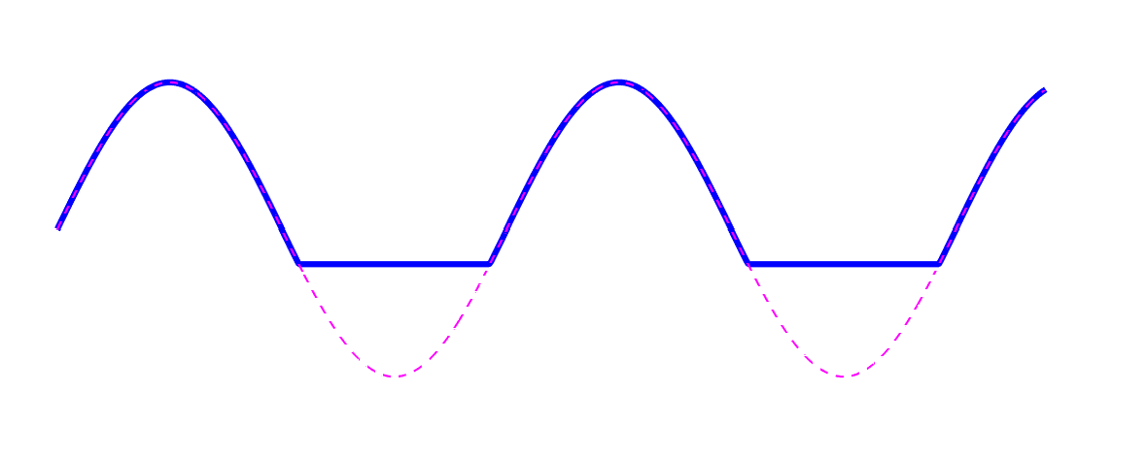
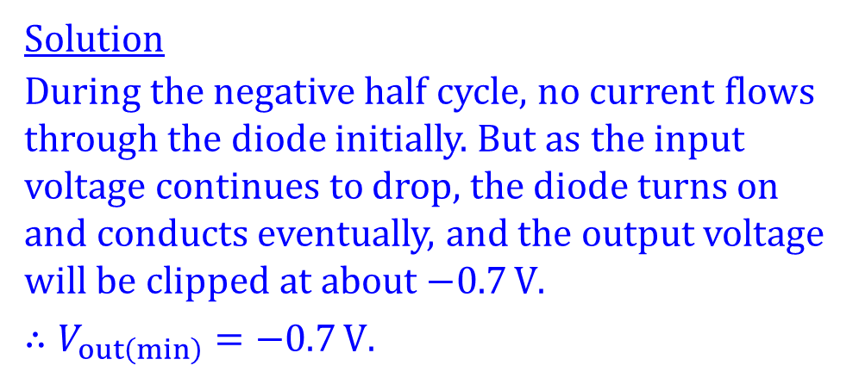

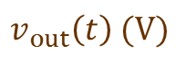
17/18 S2 B2 (modified)
$$v_{R1}$$
−0.7 V
(b) (i) A silicon diode is used in the circuit. Sketch the output voltage $v_{out}$, and indicate the maximum and minimum values.
+
−
$v_{in}(t)$
+
$$R_{1}$$
22 kΩ
+
5 V
$$R_{2}$$
33 kΩ
0 V
$$v_{out}$$
t
−5 V
−
−
Solution
During the negative half cycle, no current flows through the diode initially. But as the input voltage continues to drop, the diode turns on and conducts eventually, and the output voltage will be clipped at about $−0.7 V$.
$$∴V_{out\left(min\right)}=−0.7 V.$$
0 V
$$v_{out}\left(t\right) (V)$$
3
$$v_{out}(t)$$
0
−0.7
t
The pink dotted curve is not required in your answer. It is just for reference.
3 of 5

Slide 13
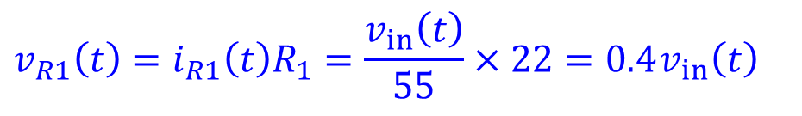
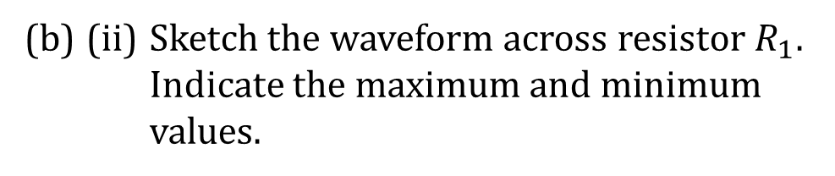
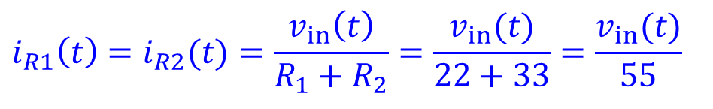
17/18 S2 B2 (modified)
$$v_{R1}$$
(b) (ii) Sketch the waveform across resistor $R_{1}$. Indicate the maximum and minimum values.
+
−
$v_{in}(t)$
+
$$R_{1}$$
22 kΩ
+
5 V
$$R_{2}$$
33 kΩ
0 V
$$v_{out}$$
Solution
During the positive half cycle, the diode is reverse biased.
t
−5 V
−
−
$$i_{R1}\left(t\right)=i_{R2}(t)=\frac{v_{in}\left(t\right)}{R_{1}+R_{2}}=\frac{v_{in}(t)}{22+33}=\frac{v_{in}(t)}{55}$$
$$v_{R1}\left(t\right)=i_{R1}\left(t\right)R_{1}=\frac{v_{in}\left(t\right)}{55}×22=0.4{ v}_{in}\left(t\right)$$
$$V_{R1\left(max\right)}=0.4 V_{in\left(max\right)}=0.4×5=2 V$$
4 of 5

Slide 14
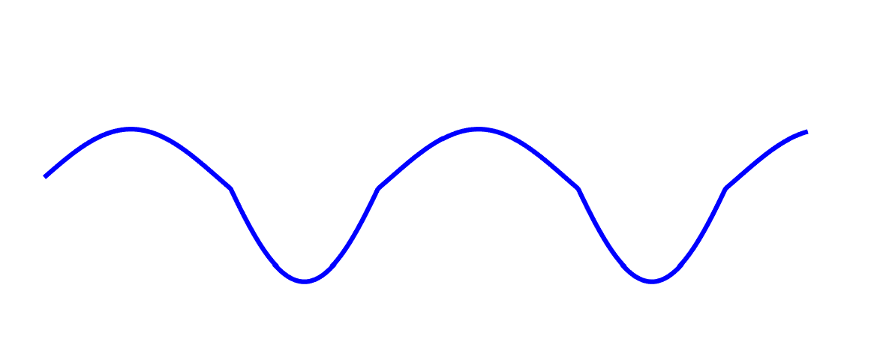
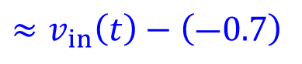
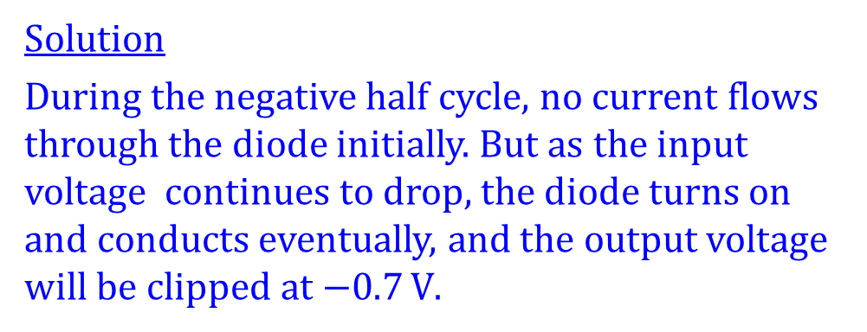
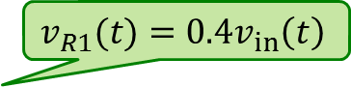

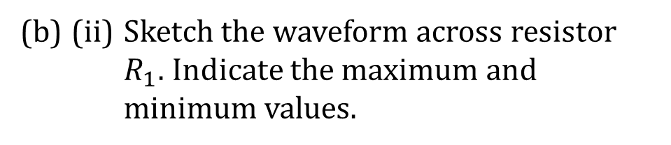
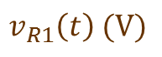
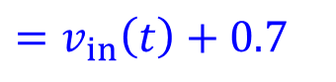
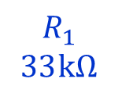
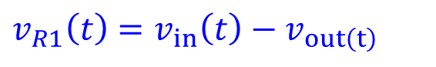
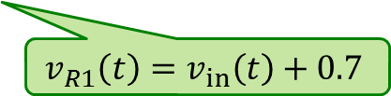
17/18 S2 B2 (modified)
(b) (ii) Sketch the waveform across resistor $R_{1}$. Indicate the maximum and minimum values.
$$v_{R1}$$
+
−
$v_{in}(t)$
+
$$R_{1}$$
33 kΩ
+
5 V
$$R_{2}$$
22 kΩ
Solution
During the negative half cycle, no current flows through the diode initially. But as the input voltage continues to drop, the diode turns on and conducts eventually, and the output voltage will be clipped at $−0.7 V$.
0 V
$$v_{out}$$
t
−5 V
−
−
$$v_{R1}\left(t\right) (V)$$
$$v_{R1}(t)={0.4v}_{in}\left(t\right)$$
$$v_{R1}\left(t\right)=v_{in}\left(t\right)−v_{out\left(t\right)}$$
2
0
t
$$≈v_{in}\left(t\right)−\left(―0.7\right)$$
−4.3
$$=v_{in}\left(t\right)+0.7$$
$$v_{R1}\left(t\right)=v_{in}\left(t\right)+0.7$$
$$V_{R1(min)}≈V_{in(min)}+0.7=−5+0.7=−4.3 V$$
5 of 5

Slide 15
2017/18 S1
Modified Examination Questions

Slide 16
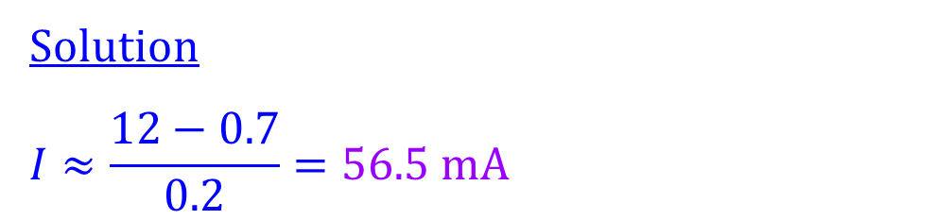
17/18 S1 A6 (modified)
Explanation
Calculate the forward current of the silicon diode.
Solution
$$I≈\frac{12−0.7}{0.2}=56.5 mA$$
6.8 kΩ
I
12 V
200 Ω
1 of 1

Slide 17
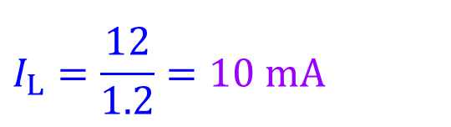
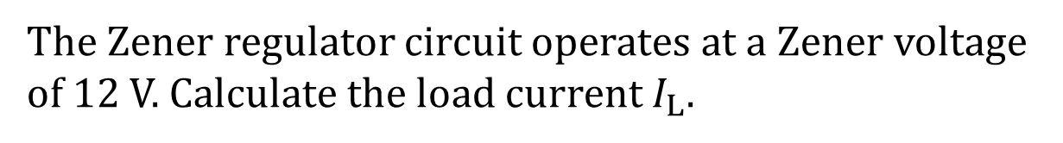
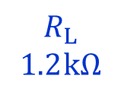
17/18 S1 A9 (modified)
Explanation
100 Ω
I
The Zener regulator circuit operates at a Zener voltage of 12 V. Calculate the load current $I_{L}$.
$$I_{Z}$$
$$I_{L}$$
$$R_{L}$$ 1.2 kΩ
20 V
Solution
$$I_{L}=\frac{12}{1.2}=10 mA$$
1 of 1

Slide 18
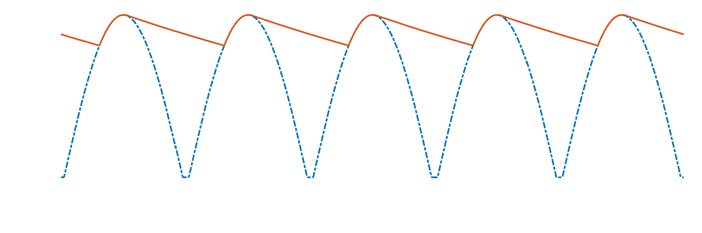
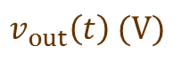

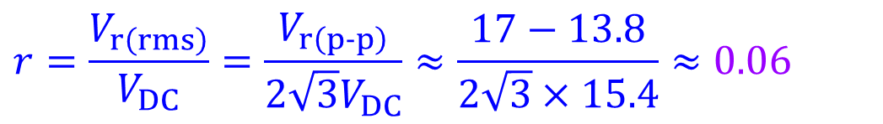

17/18 S1 B2 (modified)
Explanation
Click
(a) A filter capacitor is connected across the output of a rectifier. Calculate the ripple factor of the filtered output below.
$$v_{out}\left(t\right) (V)$$
17
13.8
$$V_{dc}≈15.4 V$$
0
$$V_{r\left(rms\right)}=\frac{V_{r\left(p‑p\right)}}{2\sqrt{3}}$$
t
Solution
$$r=\frac{V_{r\left(rms\right)}}{V_{DC}}=\frac{V_{r\left(p‑p\right)}}{2\sqrt{3}V_{DC}}≈\frac{17−13.8}{2\sqrt{3}×15.4}≈0.06$$
1 of 3

Slide 19


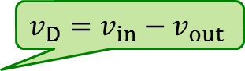
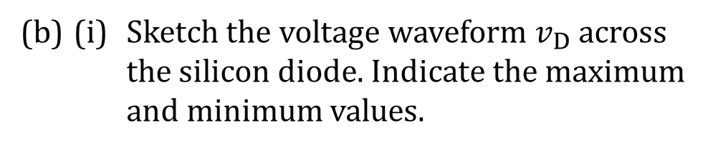
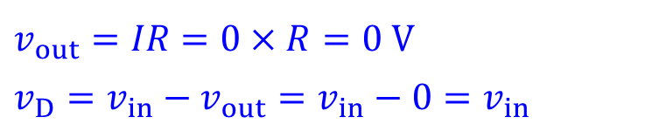
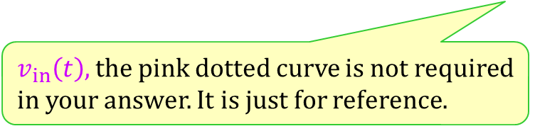

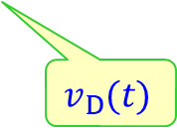

17/18 S1 B2 (modified)
$$v_{D}=v_{in}−v_{out}$$
(b) (i) Sketch the voltage waveform $v_{D}$ across the silicon diode. Indicate the maximum and minimum values.
$$v_{D}$$
+
−
$v_{in}(t)$
8.5 V
+
+
Solution
During the positive half cycle, the diode is reverse biased. No current flows through the circuit.
0 V
R
$$v_{out}$$
t
−8.5 V
−
−
$$v_{out}=IR=0×R=0 V$$
$$v_{D}=v_{in}−v_{out}=v_{in}−0=v_{in}$$
$$v_{D}\left(t\right) (V)$$
8.5
During the negative half cycle, no current flows through the diode initially. But as the input voltage continues to decrease, the diode turns on and conducts eventually.
0
−0.7
t
$${∴v}_{D}=−0.7 V$$
$$v_{D}(t)$$
$v_{in}\left(t\right),$ the pink dotted curve is not required in your answer. It is just for reference.
2 of 3

Slide 20








17/18 S1 B2 (modified)
$$v_{D}=v_{in}−v_{out}$$
$$v_{out}=v_{in}−v_{D}$$
(b) (ii) Sketch the voltage waveform $v_{out}$ across resistor R. Indicate the maximum and minimum values.
$$v_{D}$$
+
−
$v_{in}(t)$
8.5 V
+
+
Solution
During the positive half cycle, the diode is reverse biased. No current flows through the circuit.
$$v_{out}$$
0 V
R
t
−8.5 V
−
−
$$v_{out}=IR=0×R=0 V$$
$$v_{out}\left(t\right) (V)$$
During the negative half cycle, no current flows through the diode initially. But as the input voltage continues to decrease, the diode turns on and conducts eventually. Therefore,
8.5
$$v_{out}(t)$$
0
t
$$v_{D}=−0.7 V$$
$$v_{out}=v_{in}−v_{D}=v_{in}−\left(−0.7\right)=v_{in}+0.7 V$$
$$V_{out\left(min\right)}=V_{in\left(min\right)}+0.7=−8.5+0.7=−7.8 V$$
−7.8
$v_{in}\left(t\right),$ the pink dotted curve is not required in your answer. It is just for reference.
3 of 3

